Slide 1
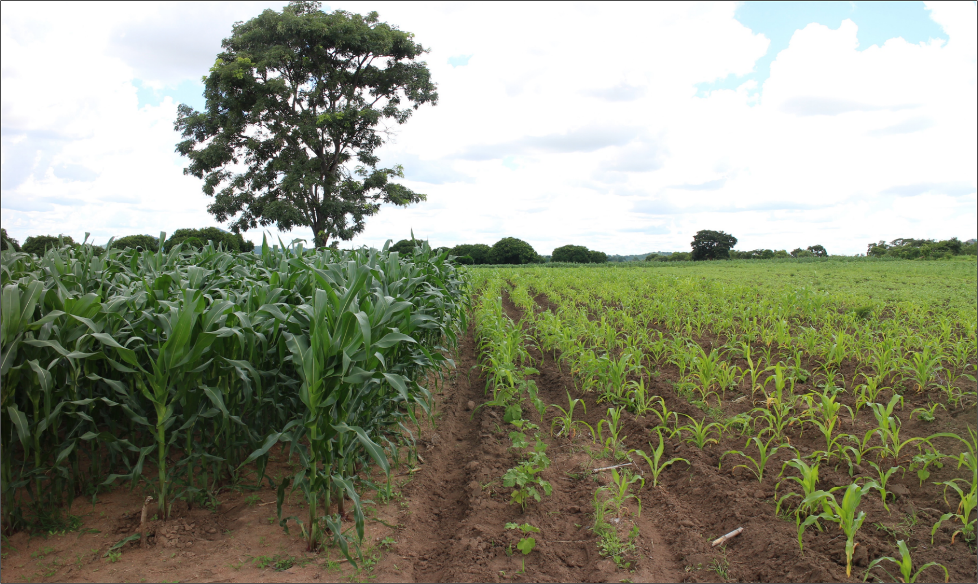
Yield gap decomposition to identify constraints to crop production in farmers’ fields
João Vasco Silva (PhD)
j.silva@cgiar.org
Agronomy-at-scale Data Scientist
CIMMYT-Zimbabwe
Addis Ababa, May 22nd 2023

Slide 2
Table of contents
Introduction
Concepts of production ecology
What is yield gap decomposition?
Processed-based crop models
Data-driven approaches
Boundary line analysis
Stochastic frontier analysis
Machine learning
Summary
Strategic applications

Slide 3
Introduction
Yield gaps to inform food security assessments and delineate scope for sustainable intensification.
Understand the relative contribution of growth defining, limiting, and reducing factors to actual farm yields.
Increasing availability of farmer field data, and environmental data, both across space and over time.
Prioritization of R&D based on the most limiting factors to crop production.
Objective: Overview of modelling and data-driven and approaches** for yield gap decomposition using farmer field data.
**Expert-based or experimental assessments not covered.

Slide 4
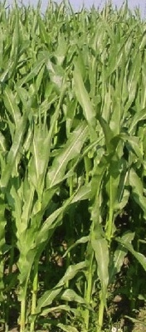
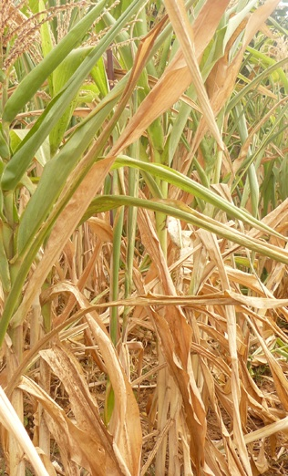
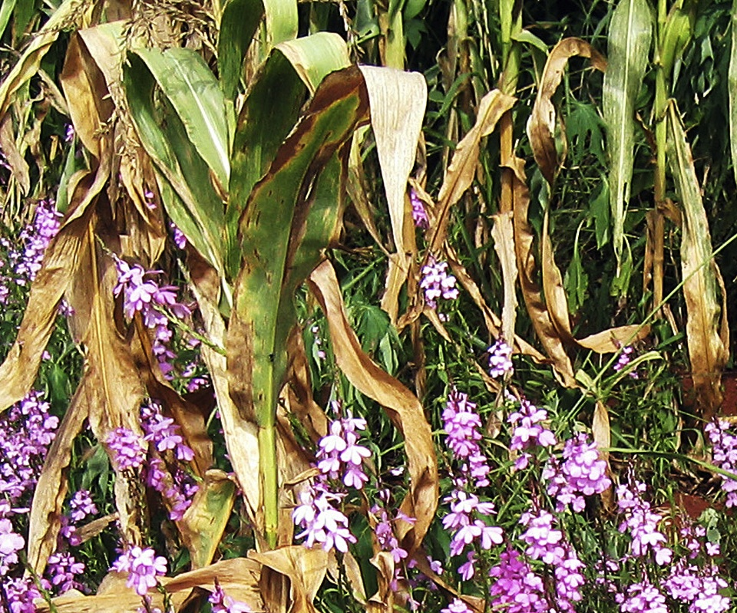
Concepts of production ecology
Defining factors
CO₂
radiation
temperature
crop genetics
Limiting factors
water
nutrients
(N,P,K)
Reducing factors
weeds
pests
diseases
pollutants
breeding
yield
increasing
measures
yield
protecting
measures
Yield level
yield gap
Potential
yield (Yp)
Limited
yield (Yw)
Actual
yield (Ya)
van Ittersum and Rabbinge (1997, FCR)

Slide 5
What is yield gap decomposition?
Regression approach: y = ax + b + ε
Crop yield increases with plant population, on average. Slope indicates rate of change.
Water-limited potential yield (Yw)
Crop yield
All data sharing similar
climate and soil type.
Plant population

Slide 6
What is yield gap decomposition?
Regression approach: y = ax + b + ε
Crop yield increases with plant population, on average. Slope indicates rate of change.
Water-limited potential yield (Yw)
Tree-based approach: non-parametric
Data space partitioned into a group with low plant population and low yield, and a group with high plant population and high yield.
Crop yield
Median group 2
Median group 1
All data sharing similar
climate and soil type.
Plant population

Slide 7
What is yield gap decomposition?
Regression approach: y = ax + b + ε
Crop yield increases with plant population, on average. Slope indicates rate of change.
Water-limited potential yield (Yw)
Tree-based approach: non-parametric
Data space partitioned into a group with low plant population and low yield, and a group with high plant population and high yield.
x is the limiting factor
Crop yield
Frontier approach:
In half the observations the yield gap is due to plant population. In the other half, the yield gap is explained by factors other than plant population.
x is one of the limiting factors
All data sharing similar
climate and soil type.
Yield gap analysis is related to analysis of actual yield variability, but it is not the same!
Plant population

Slide 8
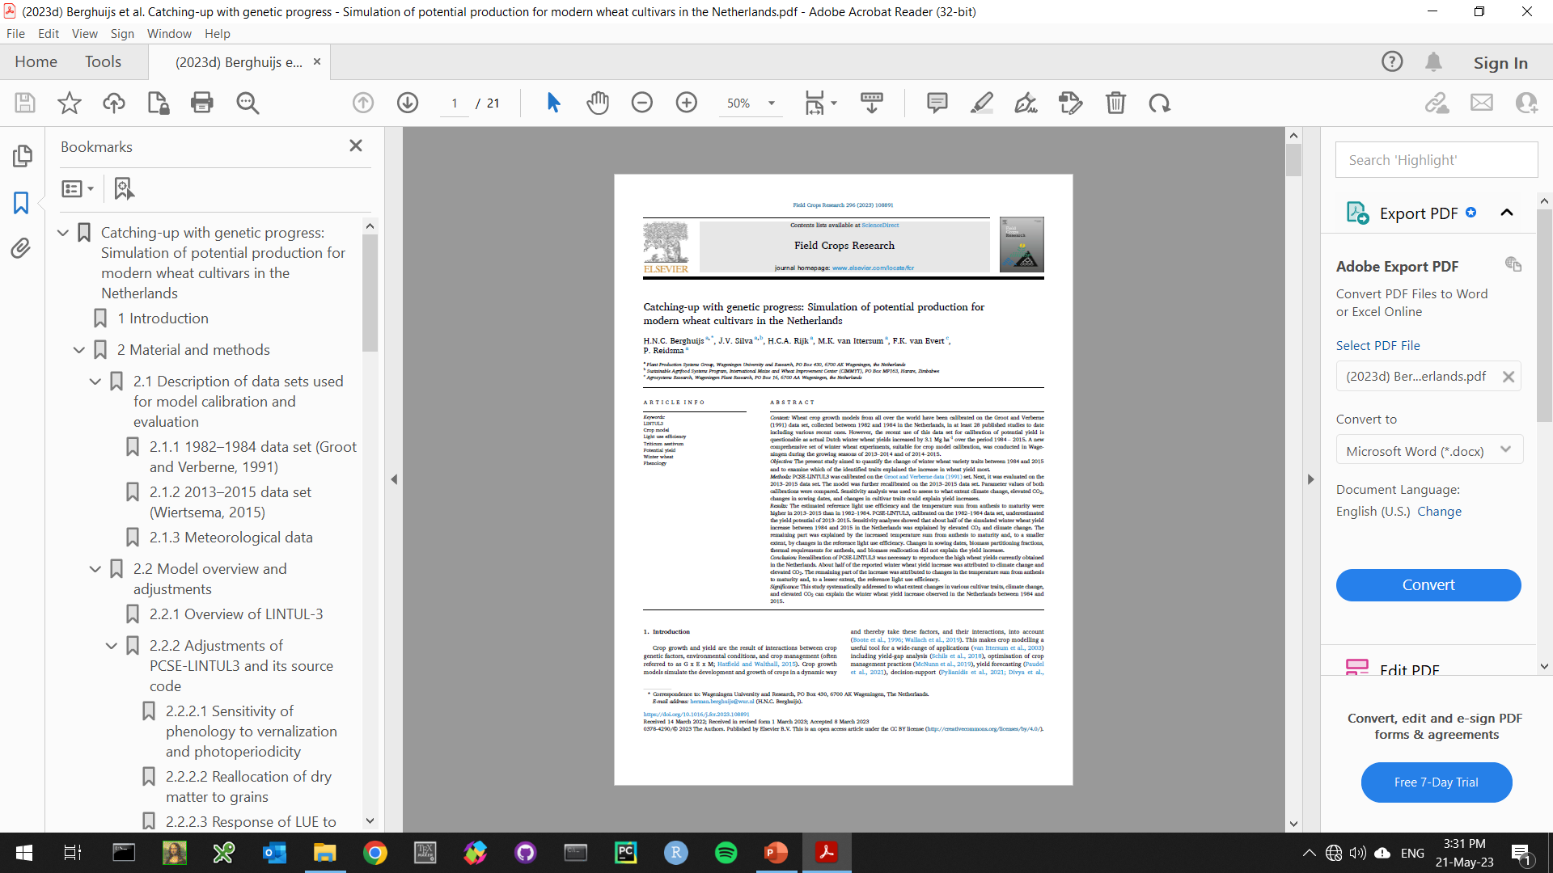
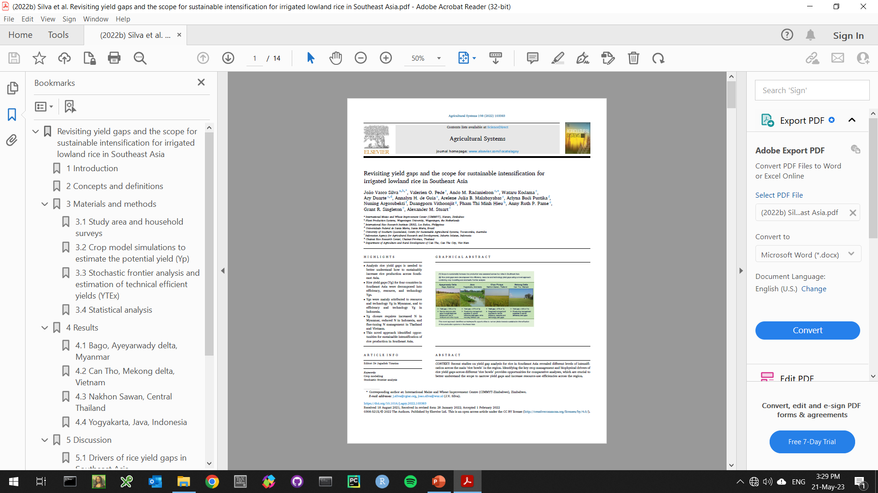
Process-based crop models
Simulation of yield levels
Simulation of mgt practices

Slide 9
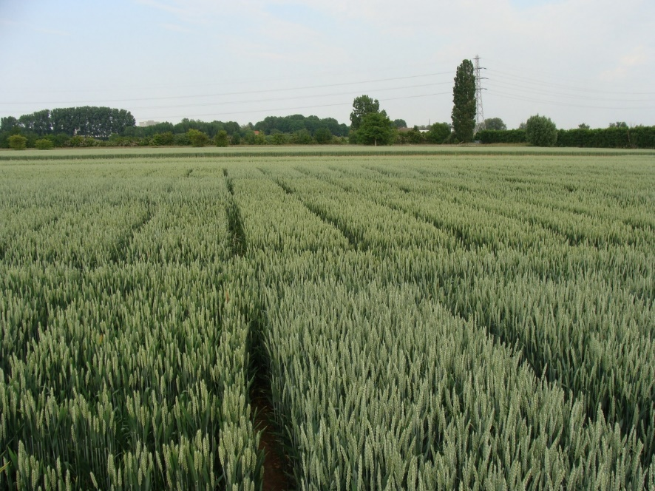
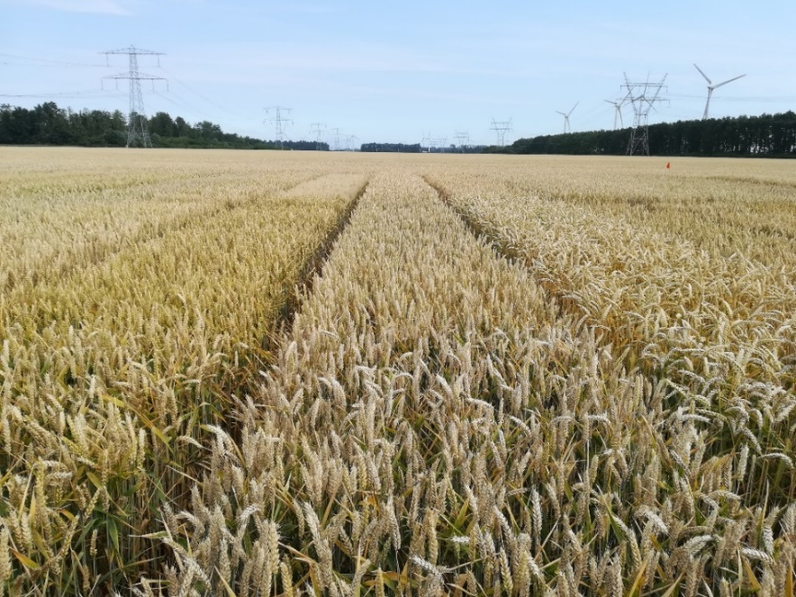
Simulation of yield levels
Winter wheat crops in the Netherlands:
High-yielding crop, due to high input use and intensive management
Important in the rotation to ensure high-yields of tuber/root crops

Slide 10
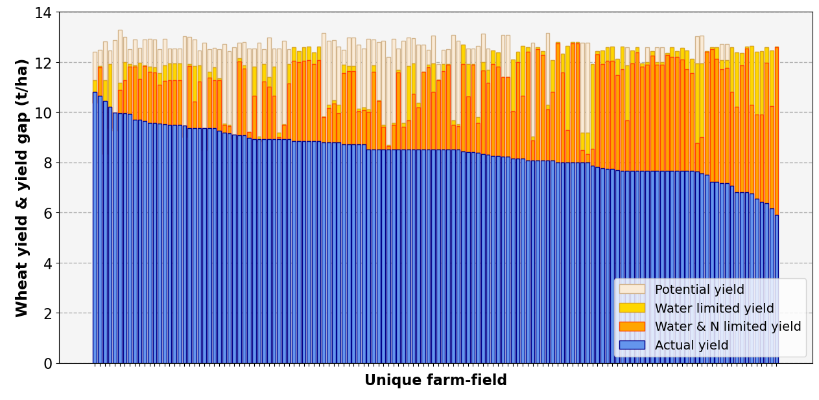
Simulation of yield levels
Water limitations
N limitations
Other factors
Yield gap closure ca. 70% of Yp
Management of other factors (e.g., diseases, crop rotations) is key to increase wheat yields in the Netherlands.
Berghuijs et al. (under review)

Slide 11
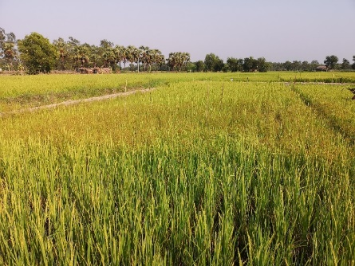
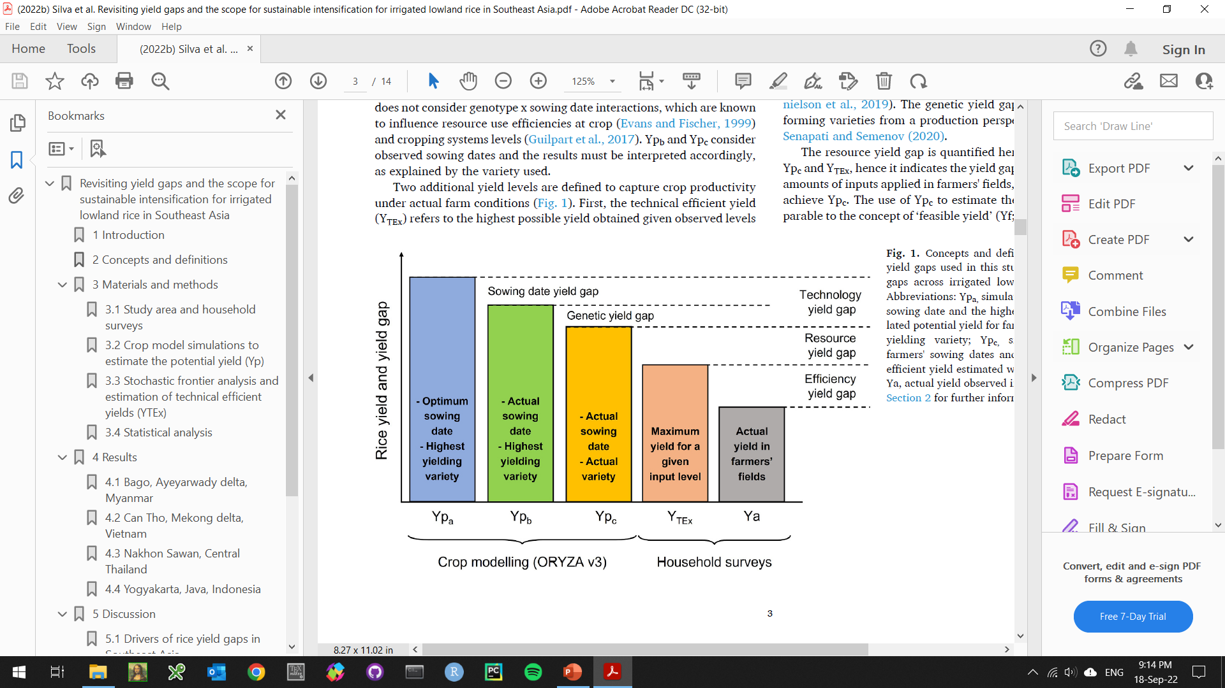
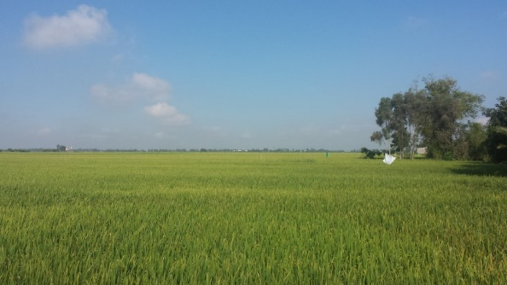
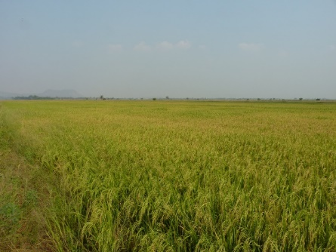
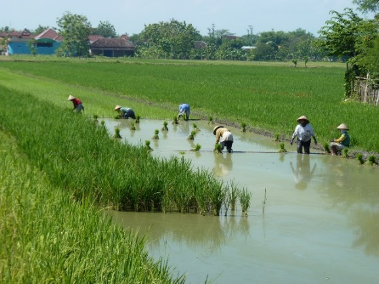
Simulation of mngt practices
Myanmar
Vietnam
Thailand
Indonesia
Silva et al. (2022, AgSys)

Slide 12
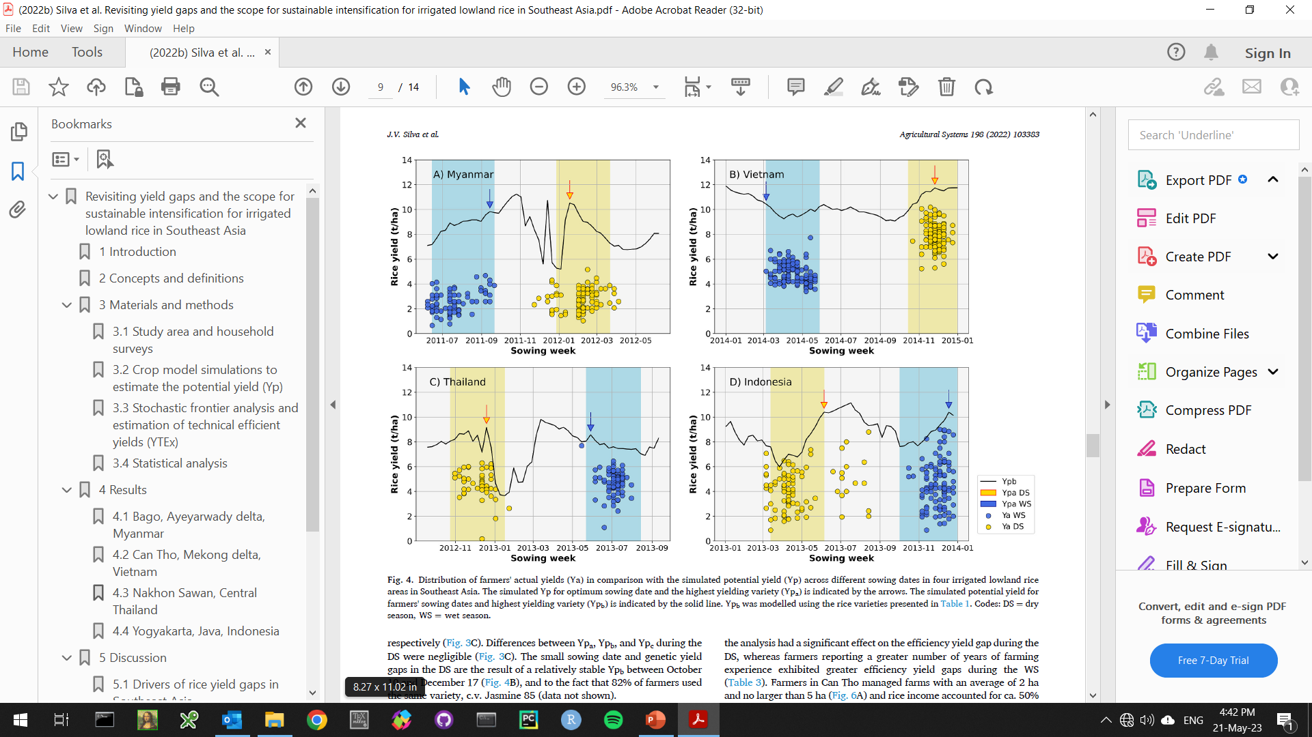
Simulation of mngt practices
Myanmar
Vietnam
Thailand
Indonesia
Silva et al. (2022, AgSys)

Slide 13
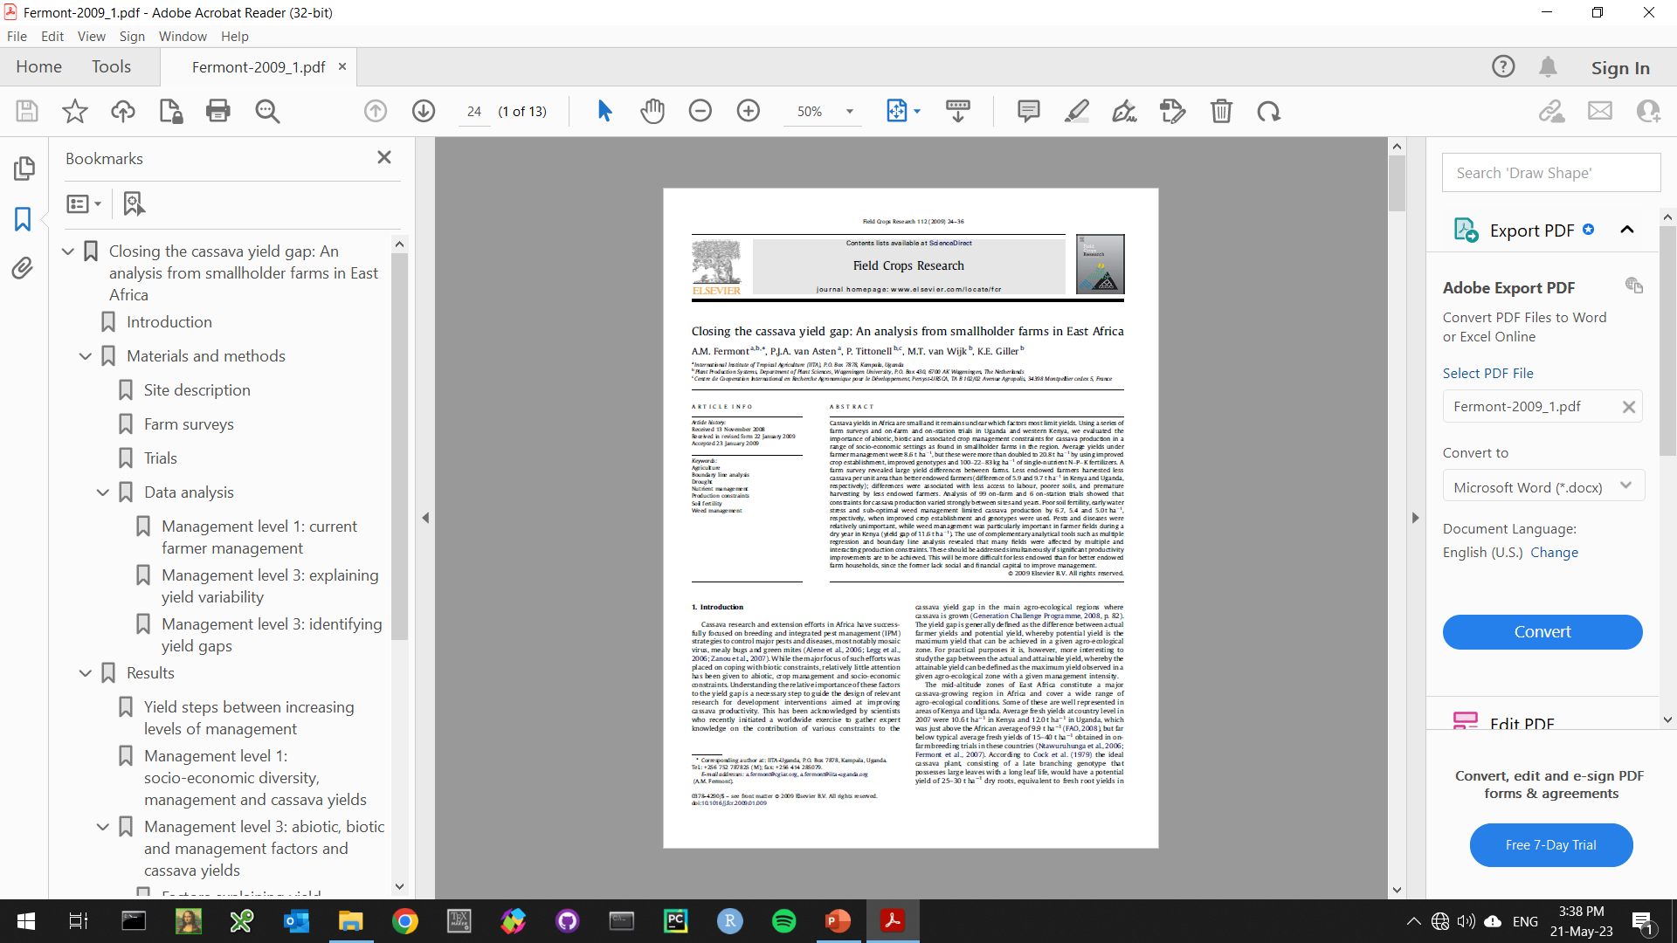
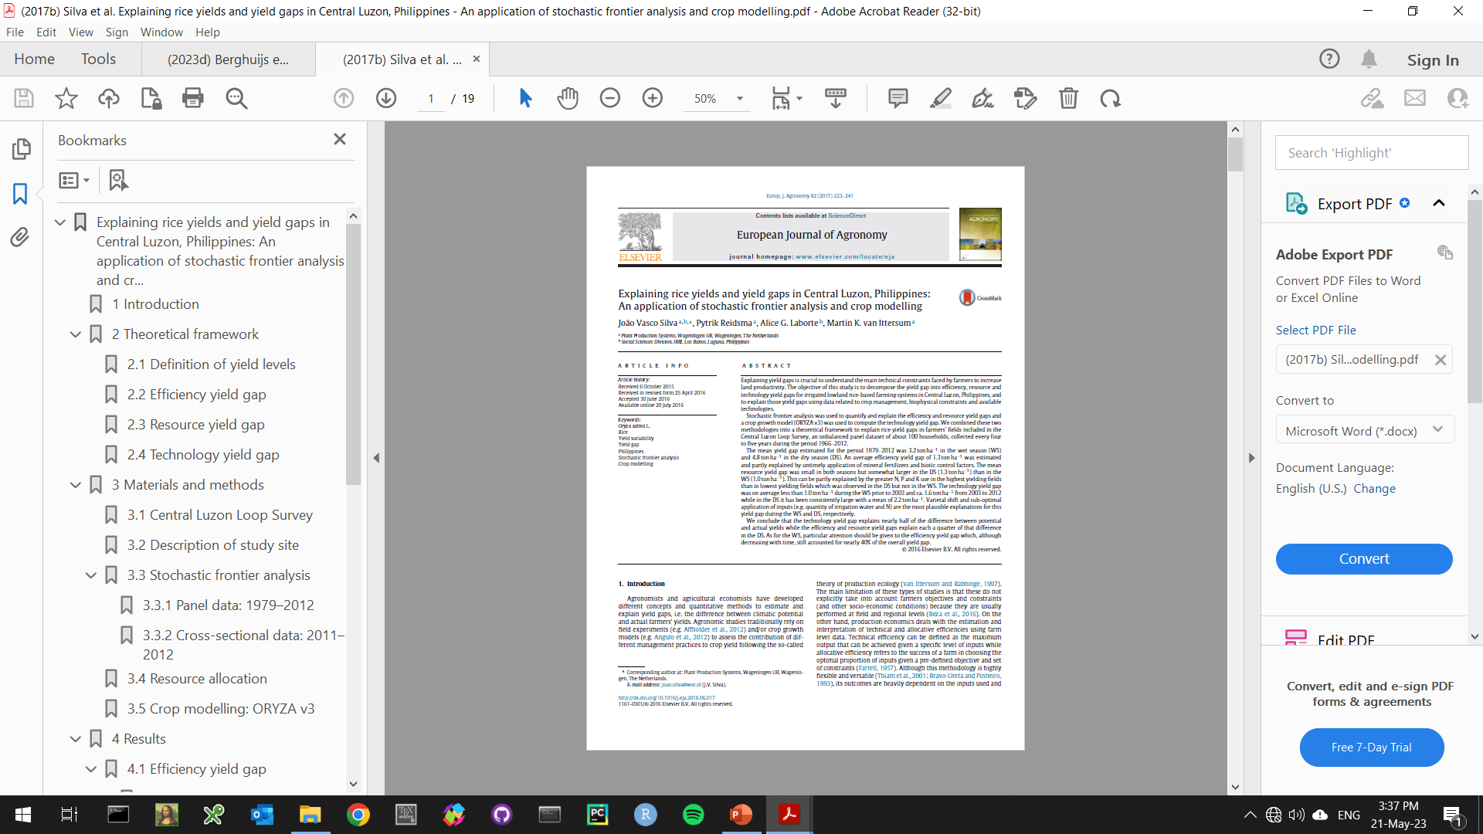
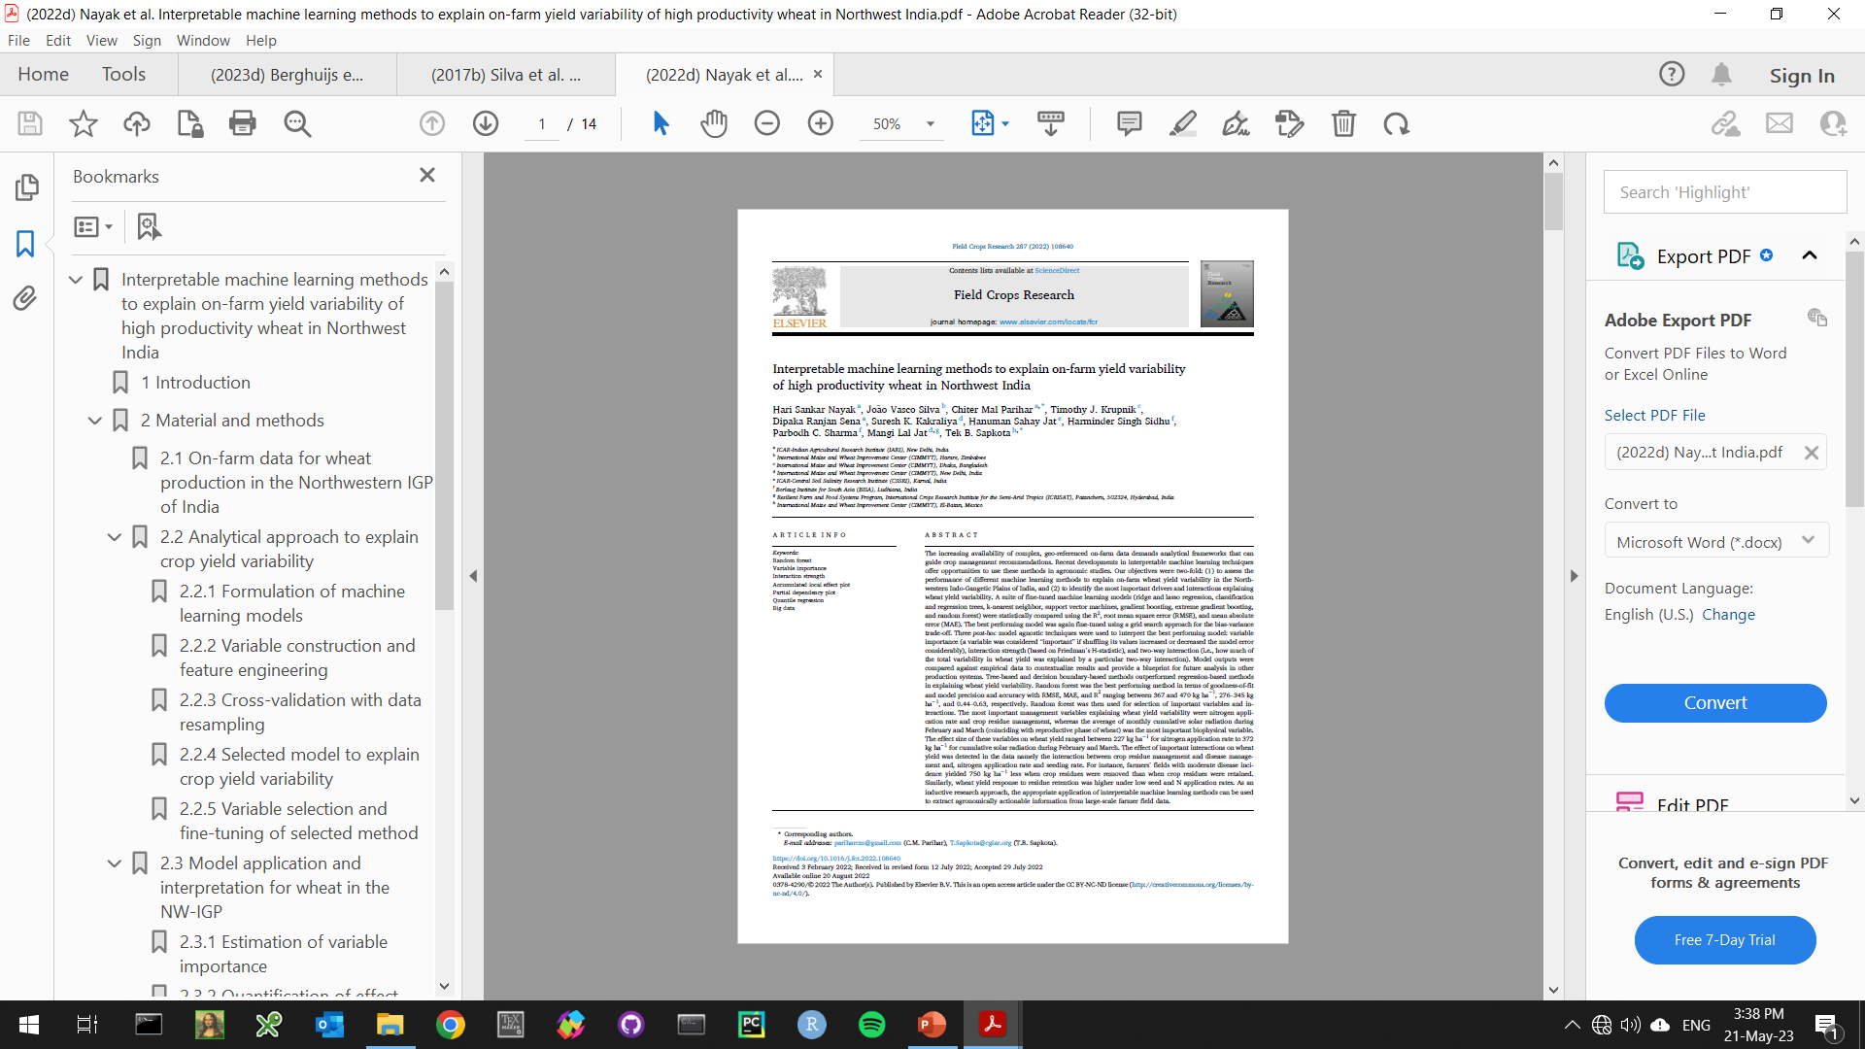
Data-driven approaches
Boundary lines
(Fermont et al., 2009)
Stochastic frontiers
(Silva et al., 2017)
Machine learning
(Nayak et al., 2022)

Slide 14
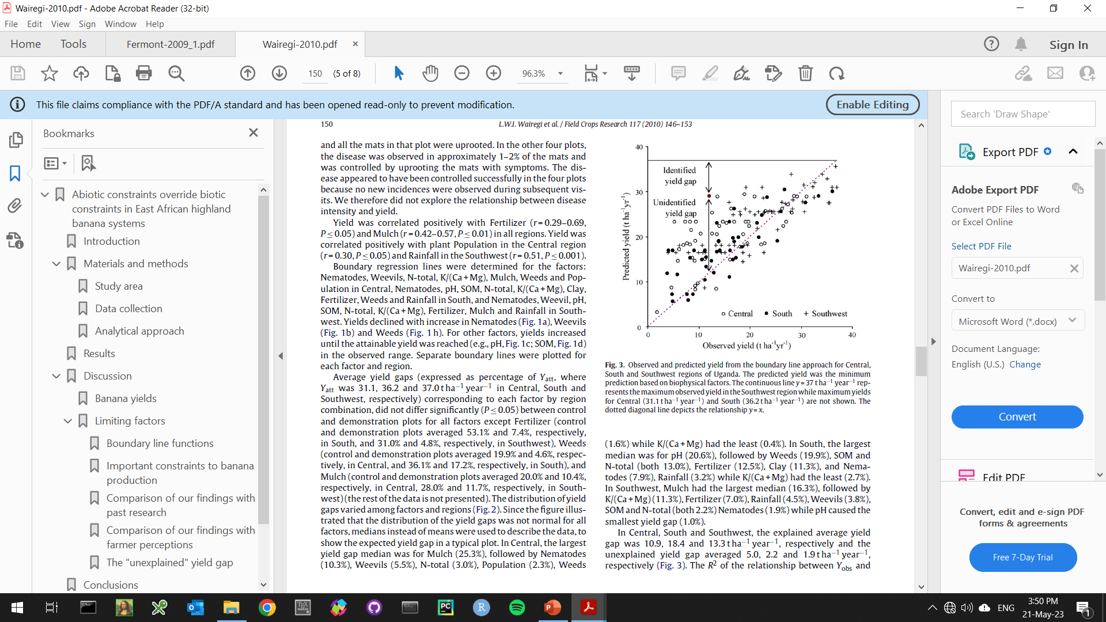
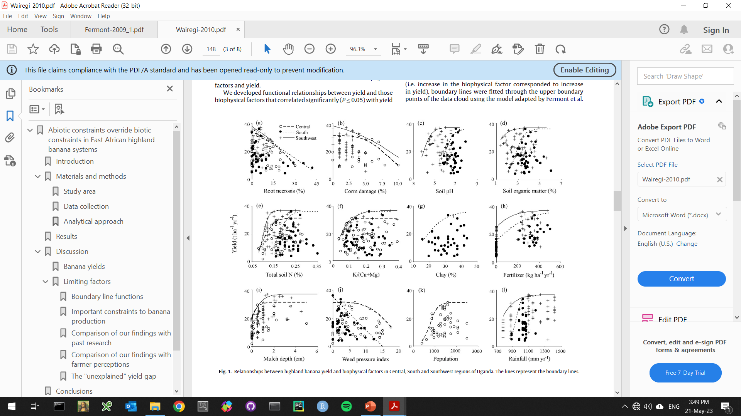
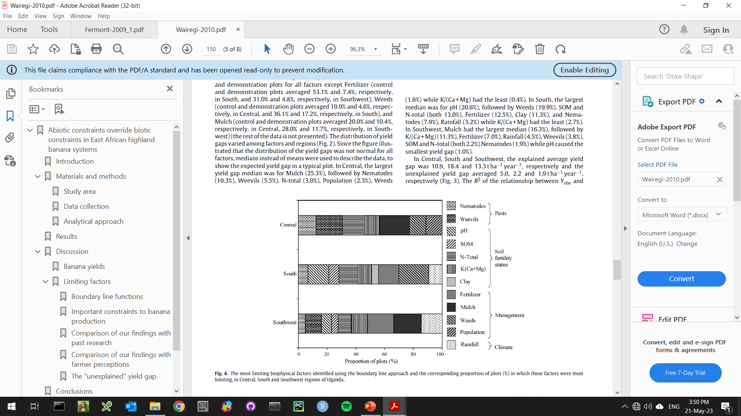
Boundary line analysis
Step 3: Yield gap analysis and identification of limiting factors.
Step 1: Identify boundary line points.
Step 2: Estimate boundary line functions.
Wairegi et al. (2010, FCR)

Slide 15
Stochastic frontier analysis
Yw
Y_{HF}
Technology
yield gap
Y_{TEx}
Resource
yield gap
Crop yield (t/ha)
Ya = actual farmers’ yields from farm survey data
Y_{TEx} = technical efficient yields estimated with stochastic frontier analysis
Y_{HF} = highest farmers’ yields based on top 10th percentile of Ya
Yw = water-limited potential yield from crop models
Efficiency
yield gap
Ya
Input use (e.g., kg N/ha)
Silva et al. (2017, EJA)

Slide 16
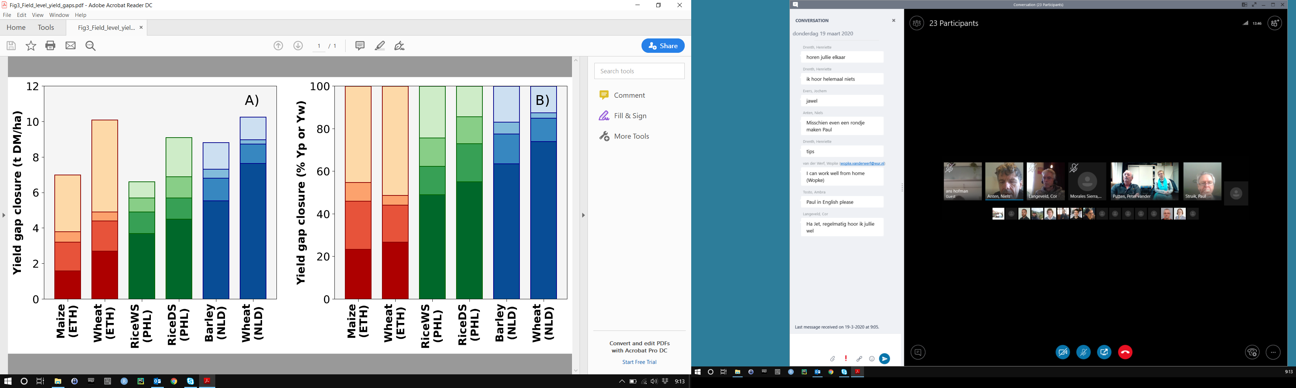
Stochastic frontier analysis
Southern Ethiopia
Large yield gap attributed to technology yield gaps.
Silva et al. (AgSys, 2019)
Central Luzon, Philippines
Medium yield gap due to efficiency,
resource and technology yield gaps.
Silva et al. (2017a, EJA)
The Netherlands
Small yield gap attributed to
efficiency yield gaps.
Silva et al. (2017b, AgSys)
Silva et al. (2021, GFS)

Slide 17
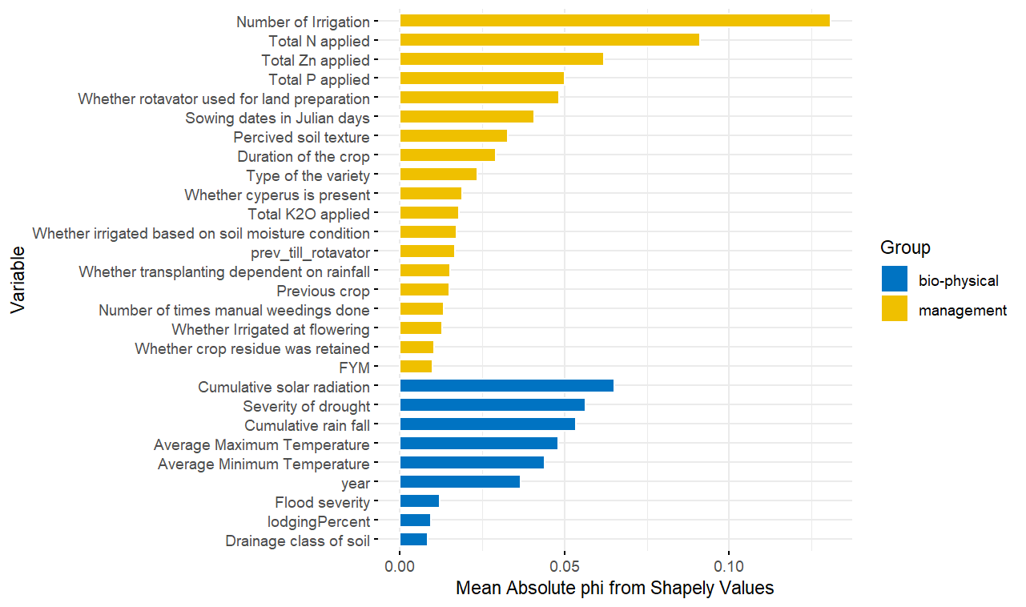
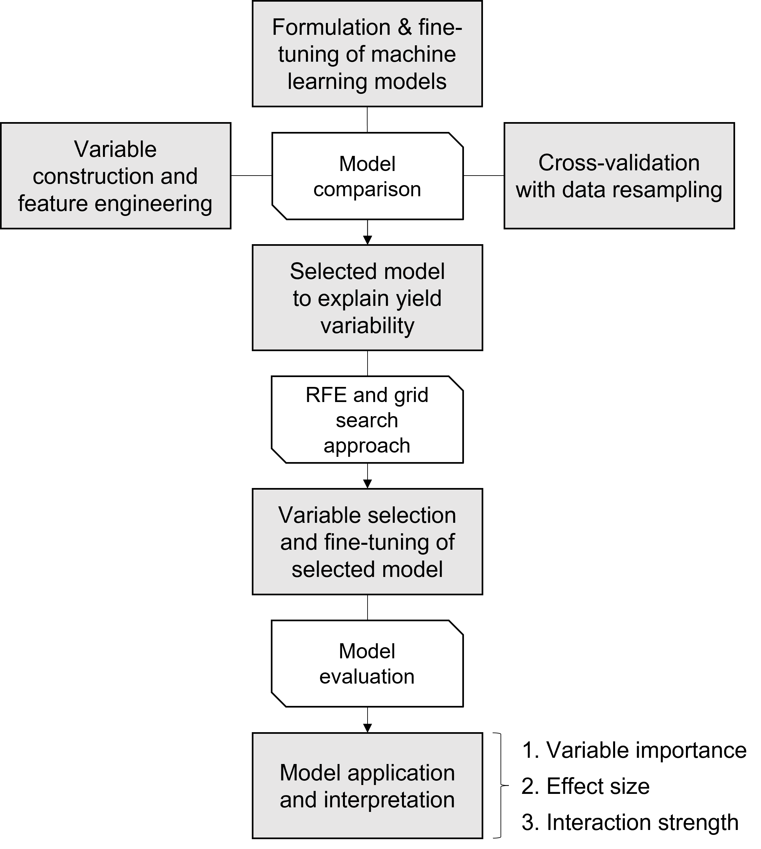
Machine learning
Variable importance/Shapely values
(!) Machine learning mostly used for analysis of actual yield variability. Its application for Yg decomposition is being finalized.
Nayak et al. (2022, FCR)

Slide 18
Summary
Some advantages:
All types of variables can be used
Less sensitive to outliers
Less subjective user decisions
Non-linear relations and interactions accounted for
No assumptions on functional forms
No problem with auto-correlation
Some disadvantages:
High sample size
High computation power
No interpretability of parameters
Script-based, Excel won’t work ☺
Machine learning
Crop growth models
Trade-offs
Interpretation of complex relations
Stochastic frontiers
Boundary lines
Low
Medium
High
Flexibility [shape of f(x)]

Slide 19
Strategic (future) applications
Web-based ‘one stop shop’ for yield gap decomposition:
Interactive display on constraints to crop productivity in EiA use cases.
Measurement and evaluation of agronomic gains (KPIs).
Global FAIR database of on-farm yield and management practices.
Achieve training materials, data collection tools, publications, etc.
Connect and capacitate agronomists and data scientists.
Prioritization of investments and R&D efforts to increase crop productivity in the Global South.
Inform national and regional policies dealing with food security, resource use efficiency, and environmental sustainability.

